Slide 1
RMS-FlowNet: Efficient and Robust Multi-Scale Scene Flow Estimation for Large-Scale Point Clouds
Ramy Battrawy¹
René Schuster¹
Mohammad-Ali Nikouei Mahani²
Didier Stricker¹
¹ German Research Center for Artificial Intelligence – DFKI, Germany
² BMW Group, Germany

Slide 2
RMS-FlowNet
Efficient scene flow network utilizing:
Random Sampling (RS).
Hierarchical prediction.
Novel flow embedding.
Accuracy is comparable to SotA methods which utilize Farthest Point Sampling (FPS) [13] (fully-supervised version).
Operates on more than > 250K at once with high accuracy and efficient computation.
Next results are analysed on a Geforce GTX 1080 Ti.
[13] Kittenplon et al. (CVPR, 2021) “FlowStep3D: Model Unrolling for Self-Supervised Scene Flow Estimation”.

Slide 3
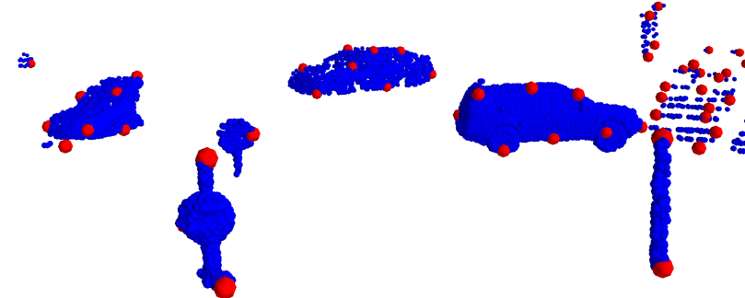
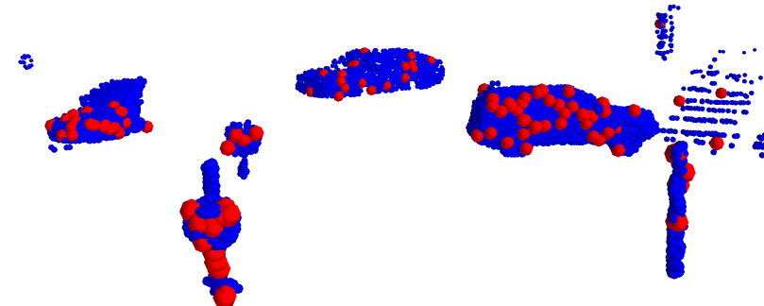
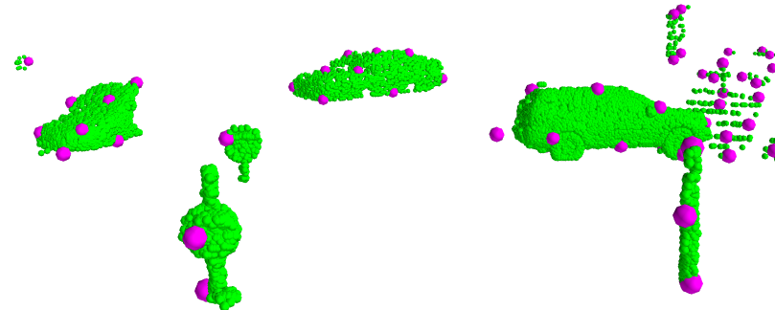
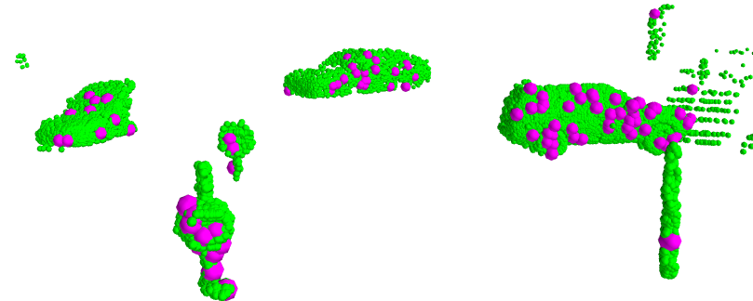
FPS vs. RS RS Challenges
Farthest Point Sampling (FPS)
Random Sampling (RS)
Similar patterns after down-sampling
$${PC}^{t}$$
$${PC}^{t}$$
$${PC}^{t+1}$$
$${PC}^{t+1}$$
RS is much efficient, however:
Over-representation for locally dense regions.
Unevenly distribution.
Dissimilar patterns.
Full Resolution ${PC}^{t}$
Full Resolution ${PC}^{t+1}$
Down-Sampled ${PC}^{t}$
Down-Sampled ${PC}^{t+1}$

Slide 4
Qualitative with Real-Word Scenes KITTI Scenes [36]: FlowStep3D [13] vs. Our RMS-FlowNet
$${PC}^{t}$$
Ground Truth + ${PC}^{t}$
Predicted + ${PC}^{t}$
Scene (8192 points)
Error Map 3D
FlowStep3D [13] w/ 1369ms
Our RMS-FlowNet w/ 77ms
[13] Kittenplon et al. (CVPR, 2021) “FlowStep3D: Model Unrolling for Self-Supervised Scene Flow Estimation”.
[36] Menze et al. (CVPR, 2015) “Object scene flow for autonomous vehicles”.

Slide 5
Qualitative with Synthetic Scenes FT3D Scenes [18]: FlowStep3D [13] vs. Our RMS-FlowNet
$${PC}^{t}$$
Ground Truth + ${PC}^{t}$
Predicted + ${PC}^{t}$
Scene (8192 points)
Error Map 3D
FlowStep3D [13] w/ 1369ms
Our RMS-FlowNet w/ 77ms
[13] Kittenplon et al. (CVPR, 2021) “FlowStep3D: Model Unrolling for Self-Supervised Scene Flow Estimation”.
[18] Mayer et al. (CVPR, 2016), “A large dataset to train convolutional networks for disparity, optical flow, and scene flow estimation”.

Slide 6
Qualitative with Synthetic Dense Scenes (1) Dense FT3D Scenes [18]: Our RMS-FlowNet
RMS-FlowNet estimate accurate scene flow for the following scenes with ~300K points at once with:
~862ms for each consecutive frames utilizing Geforce GTX1080Ti.
$${PC}^{t}$$
Ground Truth + ${PC}^{t}$
Predicted + ${PC}^{t}$
Error Map 3D
[18] Mayer et al. (CVPR, 2016), “A large dataset to train convolutional networks for disparity, optical flow, and scene flow estimation”.

Slide 7
Qualitative with Synthetic Dense Scenes (2) Dense FT3D Scenes [18]: Our RMS-FlowNet
RMS-FlowNet estimate accurate scene flow for the following scenes with ~400K points at once with:
~1078ms for each consecutive frames utilizing Geforce GTX1080Ti.
$${PC}^{t}$$
Ground Truth + ${PC}^{t}$
Predicted + ${PC}^{t}$
Error Map 3D
[18] Mayer et al. (CVPR, 2016), “A large dataset to train convolutional networks for disparity, optical flow, and scene flow estimation”.

